Slide 1
First Workshop on Metalearning in 1998 at ECML
8 papers (2 by organizers!)
About 20 attendees
EU-heavy
Then ICML 1999, ECML 2000, ECML 2001, etc.
MLJ SI on Metalearning, 2004
First Workshops on AutoML/Metalearning in 2014 at ECAI/2015 at ECML
Look at today!
29 accepted papers / ~100 attendees
Wide range of origins

Slide 2
Informing the Use of Hyper-Parameter Optimization Through Metalearning
Parker Ridd, Samantha Sanders,
Christophe Giraud-Carrier

Slide 3
Many Metalearning Approaches
Assume that for all base classification learning algorithms, the parameter setting is fixed to some default
Consequently:
The problem of metalearning for classifier selection is greatly simplified
Such approaches attract at best serious criticism, and at worst, plain dismissal from the community
WHY?

Slide 4
Hyper-parameter Optimization Claim
Hyper-parameter optimization (HPO) has a significant impact (for the better) on the predictive accuracy of classification learning algorithms

Slide 5
Consequently…
Two possible approaches:
Two-stage metalearning
Solve restricted version of the problem (i.e., with default parameter setting)
Optimize hyper-parameters for selected algorithm
Unrestricted metalearning
Select both the classifier and its hyper-parameters at once
Two-stage metalearning may be sub-optimal
Unrestricted metalearning is expensive

Slide 6
Is This Reasonable?
Almost everybody believes that the claim of hyper-parameter optimization holds
Almost nobody has attempted to verify its validity either theoretically or empirically
Do you see the problem?
What if it does not hold in general?
What if it only holds in specific cases?
Shouldn’t we find out what those cases are?
We use metalearning to address these questions

Slide 7
There Is One Study…
Sun and Pfahringer considered 466 datasets and reported on the percentage of improvement of the best AUC score among 20 classification algorithms after parameter optimization (using PSO) over the best AUC score among the same classification algorithms with their default parameter settings.

Slide 8
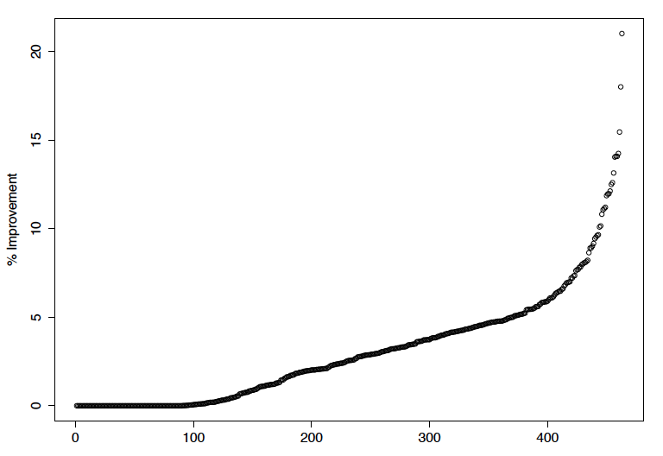
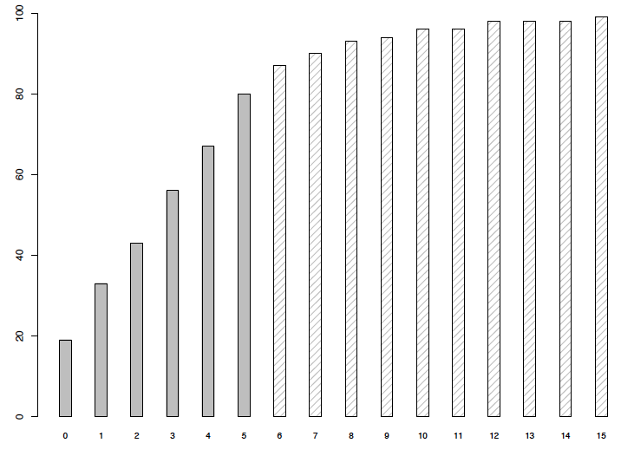
Impact of HPO by Increasing Value of Improvement
Impact highly variable across datasets
For 19% of the datasets, HPO offers no improvement at all
Improvement does not exceed 5% for 80% of the datasets
Linear relationship (slope=12) from 0% to 5%

Slide 9
Why This Matters
HPO does not improve performance uniformly across datasets
For many datasets, very little improvement and thus computational overkill
For some datasets, significant difference and thus beneficial
Important because HPO is expensive
Auto-Weka took on average 13 hours per dataset in the work of Thornton et al
Much of this is wasted if significant improvement is only observed in a small fraction of cases (possibly none depending on the datasets)

Slide 10
Metalearning Impact of HPO – Take 1
Data preparation
Remove small datasets (<= 100)
Extract meta-features for each dataset (Reif’s tool)
Meta-feature selection (manual and CFS)
Label datasets (0 for no advantage and 1 for likely performance advantage)
Select metalearner – comprehensibility and preliminary results → J48

Slide 11
Threshold = 1.5
Default: A=62%, P=62%, R=100%
Feature selection + J48
joint entropy, NB, NN1
A=79%, P=81%, R=86%
NN1 root of induced tree
Good recall on test data
Metamodel claims 83% of the total performance improvement available at the base level

Slide 12
Threshold = 2.5
Default: A=50%, P=50%, R=100%
Feature selection + J48
kurtosis prep, normalized attribute entropy, joint entropy, NB, NN1
A=75%, P=71%, R=84%
NN1 root of induced tree
Good recall on test data
Metamodel claims 74% of the total performance improvement available at the base level

Slide 13
Larger Threshold Values
Shifts majority to class 0
Fewer class 1 datasets, but great benefit in identifying them
Metalearning difficult due to class imbalance
Threshold = 5.0
Recall goes from 0% to 26% (10 of 54 datasets)
NN1 root of induced tree
Poor results beyond

Slide 14
An Unexpected Finding
In virtually all metamodels, NN1 is the root of the induced tree
Linear regression of the actual percentage of improvement on the meta-features also assigns large weight to NN1
Confirms Reif et al’s results that landmarkers are generally better than other meta-features, especially NN1 and NB
NN1 is very efficient, hence the determination could be very fast

Slide 15
Study 1 Suggests…
Two-stage approach may indeed be adequate, but the correct one consists of:
Determining whether HPO is likely to yield improvement
If so, solving the unrestricted version of the problem
Limitations:
Aggregate analysis: best default vs. best HPO
All datasets binarized
No test of significance
Cost of HPO ignored

Slide 16
Metalearning Impact of HPO – Take 2
Repeat Study 1 on per-algorithm basis:
When HPO improves algorithm A
How long HPO takes to exceed default performance
How much HPO improves A within budget T

Slide 17
Experiment Components
Optimization Method
Genetic Algorithm (24 hours to optimize)
Performance Measure
Multi-Class AUC
Datasets
229 (raw) datasets from OpenML
Algorithms
MLP, SVM, Decision Tree (scikit-learn)

Slide 18
Hyper-parameters
Decision Tree (8)
split criterion, max depth, max leaves, etc.
MLP (18)
Hidden layer, learning rate, momentum, etc.
SVM (5)
C, kernel, gamma, etc.

Slide 19
Data Collection
For default and HPO experiments:
30 starts × 3 algs × 229 datasets = 20,610 data points
Stop:
Perfect MAUC or 24 hrs
Label:
95% confidence intervals for default and HPO
No overlap -> optimize, otherwise no
Extract meta-features, metalearn
Time (sec.) | Generation | Parameters | Fitness (MAUC)
13.37 | 1 | split=entropy ... | 0.8684
34.45 | 2 | split=gini ... | 0.8743
63.79 | 3 | split=gini ... | 0.8748

Slide 20
When HPO Helps
TL;DR -- Almost always

Slide 21
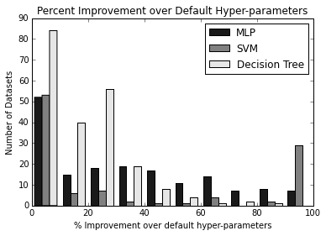
HPO Improvement over Default

Slide 22
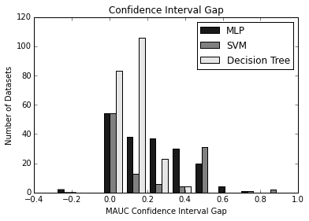
MAUC Confidence Interval Gap
7,2,2
Default yields perfect MAUC

Slide 23
Since Improvement Is Most Likely: How Much Does HPO Helps

Slide 24
Experiment Components
Metalearner
MLP
Performance Metrics
Correlation Coefficient, MAE, RMSE
Dataset
Meta-feature dataset (PCA)
To Predict
Improvement in MAUC for DT, SVM, MLP

Slide 25
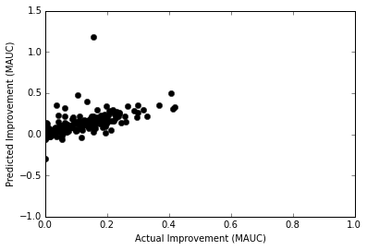
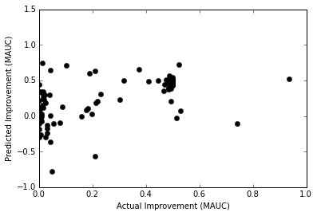
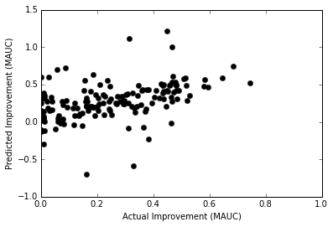
Results
Meta-feature Dataset | Correlation Coefficient | Mean Absolute Error | Root Mean Squared Error
Decision Tree | 0.56 | 0.06 | 0.11
SVM | 0.54 | 0.17 | 0.26
MLP | 0.47 | 0.15 | 0.23

Slide 26
Predicting How Long it Will Take to Beat Default Settings

Slide 27
Experiment Components
Metalearner
Decision Tree
Performance Metrics
Accuracy, Precision, Recall, ROC Area
Dataset
Meta-feature dataset
To Predict
Will it take more or less than X minutes to exceed performance of default hyper-parameters?

Slide 28
MLP Dataset Results
Runtime Cutoff | Baseline Acc. (prediction) | Accuracy | Precision | Recall | ROC Area
30 Min | 56% | 90% | 0.91 | 0.87 | 0.91
1 Hour | 57% | 90% | 0.91 | 0.92 | 0.91
3 Hours | 68% | 88% | 0.93 | 0.90 | 0.90
Precision: Instances labeled as needing less than T to reach default hyper-parameter benchmark, actually need less than T.
Recall: Instances needing less than T to reach the default hyper-parameter benchmark are actually labeled as such.

Slide 29
SVM Dataset Results
Runtime Cutoff | Baseline Acc. (prediction) | Accuracy | Precision | Recall | ROC Area
30 Min | 58% | 88% | 0.86 | 0.84 | 0.86
1 Hour | 50% | 81% | 0.82 | 0.80 | 0.78
3 Hours | 77% | 73% | 0.81 | 0.85 | 0.58

Slide 30
Decision Tree Dataset Results
Runtime Cutoff | Baseline Acc. (prediction) | Accuracy | Precision | Recall | ROC Area
10 Sec | 52% | 89% | 0.90 | 0.87 | 0.91
60 Sec | 68% | 91% | 0.94 | 0.92 | 0.88
30 Min | 97% | 97% | 0.98 | 0.98 | 0.68

Slide 31
Our (Not So) Unexpected Friend Again
For all metamodels predicting improvement within budget, NN1_time is the root of the induced tree
Confirms early results
Warrants further investigation into NN1 and other landmarkers

Slide 32
Study 2 Suggests…
Statistically significant improvement of HPO over default can be achieved in almost all cases
Study 1? – maybe more datasets had perfect performance with default (446/229), binarization, etc.
It seems we can:
Predict with some degree of accuracy, how much improvement can be expected
Predict if default hyper-parameter performance can be improved upon within a given time budget

Slide 33
Parting Thoughts
Directly related
Repeat with more learning algorithms
Metamodels vs. joint optimization
More broadly
Need continued work on metalearning (WSs, etc.)
Thankless!
MLJ SI on Metalearning Jan 2018
DARPA D3M Project

